Slide 1








Lesson 1. Angular Component Lifecycle Hooks

Slide 2
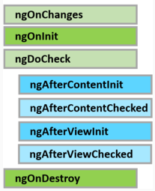

Angular Component Lifecycle Hooks
A component has a lifecycle managed by Angular. Angular
Creates the component
Renders the component
Creates and renders the component children
Checks when the component data-bound properties change, and
Destroys the component before removing it from the DOM
To tap into and react when these life cycle events occur, angular offers several lifecycle hooks

Slide 3
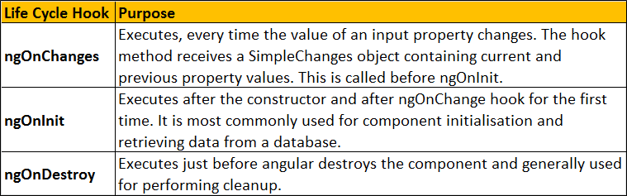
Angular Component Lifecycle Hooks
The 3 most commonly used hooks

Slide 4
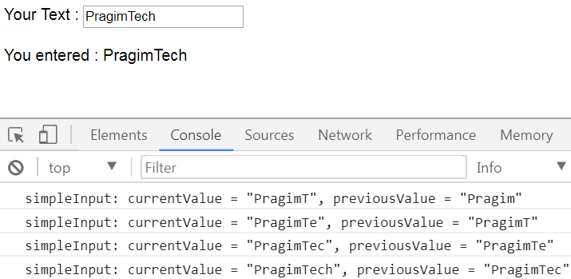
Angular Component Lifecycle Hooks
ngOnChanges Life Cycle Hook Example :

Slide 5

Angular Component Lifecycle Hooks
3 Simple Steps to use the Life Cycle Hooks
Step 1 : Import the Life Cycle Hook interface
Step 2 : Make the component class implement the Life Cycle Hook interface
Step 3 : Write the implementation code for the life cycle interface method

Slide 6
Q & A
Contact:rashmipawaskar@synergetics-india.com

Slide 7
Thank You

